Slide 1
Infield Throws to First Base Outs Above Average (OAA)
Tanner Smith

Slide 2
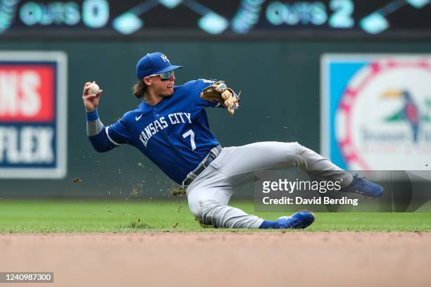
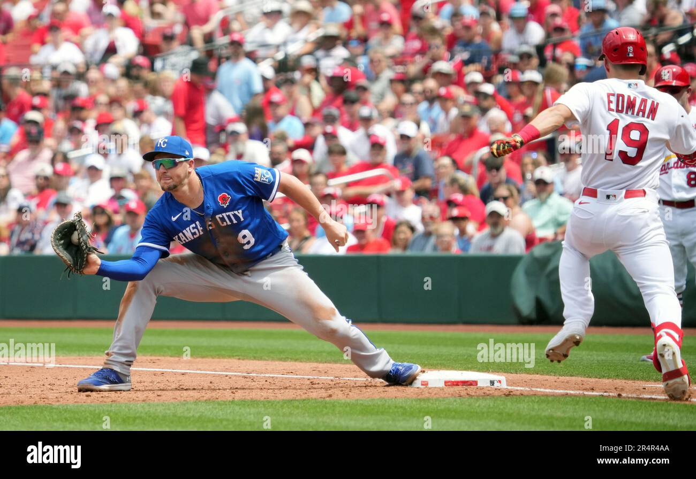
Metric Goal and Framework
Goal: Determine how much value infielders provide with their throws, + or -
Framework:
Probability of an Out Before The Throw (at time of catch, call this Moment A)
Probability of an Out After The Throw (at time of catch at first base, call this Moment B )

Slide 3
Model Details On OAA Throws to First Base
Value of Infielder Throw = Moment B – Moment A
Moment A Features
Moment B Features
Fielder Position
Throw Distance
How Far the Batter Is Down the Line When the Throw Is About To Happen
Batter Speed at the Moment the Throw Is About to Happen
Everything From Moment A Features + :
Exchange Time
Throw Velocity
Whether the Throw Bounced or Not
Overall Accuracy: When we asked the model to predict whether a play resulted in an out or not, 4,106 out of 4,312 plays (95%) were predicted accurately.

Slide 4
Assumptions, Limitations and Future Considerations
This is an initial model – The approach is to make things as simple and limited as possible at first to ensure functionality, and then leave room for future improvements later.
This is only counting throws from 2B, 3B or SS – C and P throws to 1B are often happening in much different circumstances, and we wanted to keep this initial model as simple and uniform as possible.
We are assuming all bounces are bad – This is not true in all cases, as occasionally infielders try to bounce throws, but for initial simplicity and because we do not have the angle of the bounce, only the velocity available, we wanted to instead just use whether the throw bounced or not.
We tried 2 other classification model types, this model did the best at predicting when throws would result in outs and when they would not, making it the clear choice.

Slide 5
Assumptions, Limitations and Future Considerations Cont.
We are only using cases where the same fielder who caught the ball threw the ball – Double Play Throws or relays from the outfield are fundamentally different plays that could be captured in additional models. We want to look at cookie cutter cases where an infielder fields a ground ball and throws it to first base.
We are assuming all fielders are trying to record outs – Figuring out effort level and whether infielders were trying to get an out is beyond the scope of this model. We assume all infielders are throwing with intention to record an out.
All first basemen are treated as the same – This is obviously not true and a simplification, but we would prefer to assess first base receiving skill in a separate model. For this model we are ignoring first baseman skill.
Each Play Only Accounts for 1 Out – The throw to first base itself is only accounting for 1 out. We are ignoring any odd scenarios such as 4-3-6 or 5-3-6 DPs

Slide 6
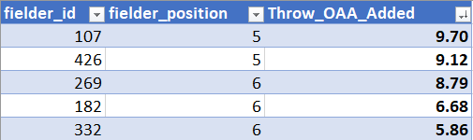
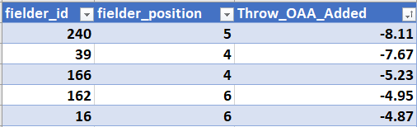
Player Leaderboard
Top 5
Bottom 5

Slide 7
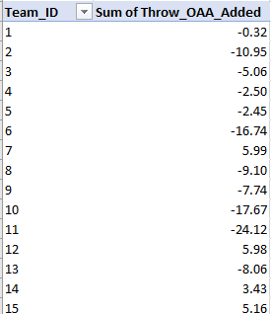
Takeaways
The Takeaways here are mostly common sense conclusions but the fact that they line up with common sense helps us feel good about the legitimacy of the predictions.
Throws From Second Base Have a Higher Out Probability than Throws from Shortstop or Third Base – as we would expect
The faster the runner is running, the lower out probability results
Bouncing throws is bad, while throwing the ball harder is good for recording outs
Table at Right: OAA Added or Subtracted by Team

